Slide 1
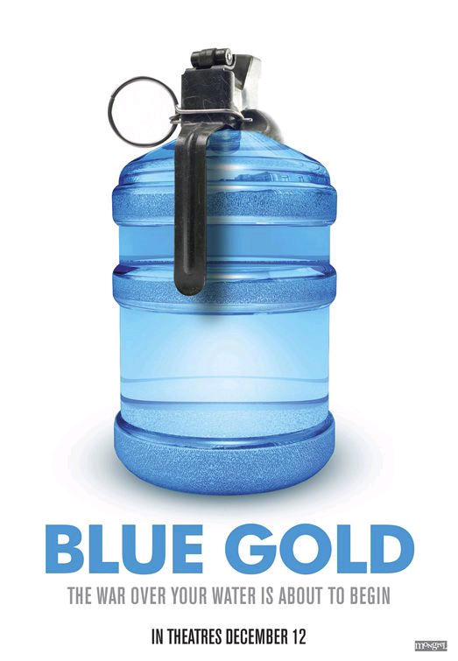
Water Wars
Reality or hype?
David Holmes – Principal Examiner
Notes:
‹#›

Slide 2
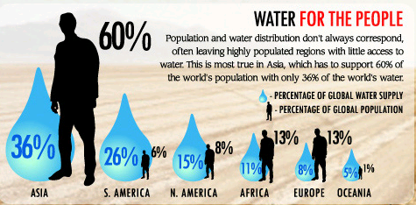
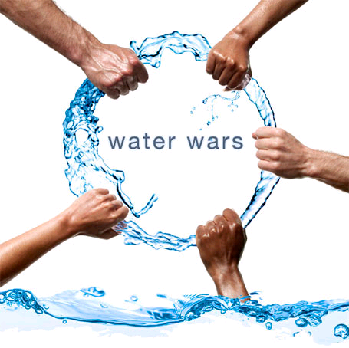
Context: Water Wars?
Conflicts over water
This perhaps is an illustration of the ‘water gap’
Notes:
‹#›

Slide 3
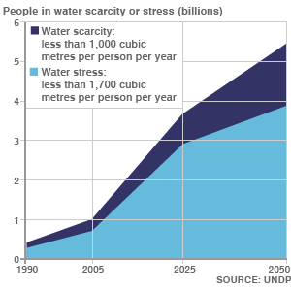
Scarcity and Stress
Overall picture is of increasing risk of large numbers of people short of water (stress) or chronically short of water (scarcity).
Reasons are physical and economic .
Climate change likely to make matters worse.
A rising trend
Notes:
‹#›

Slide 4
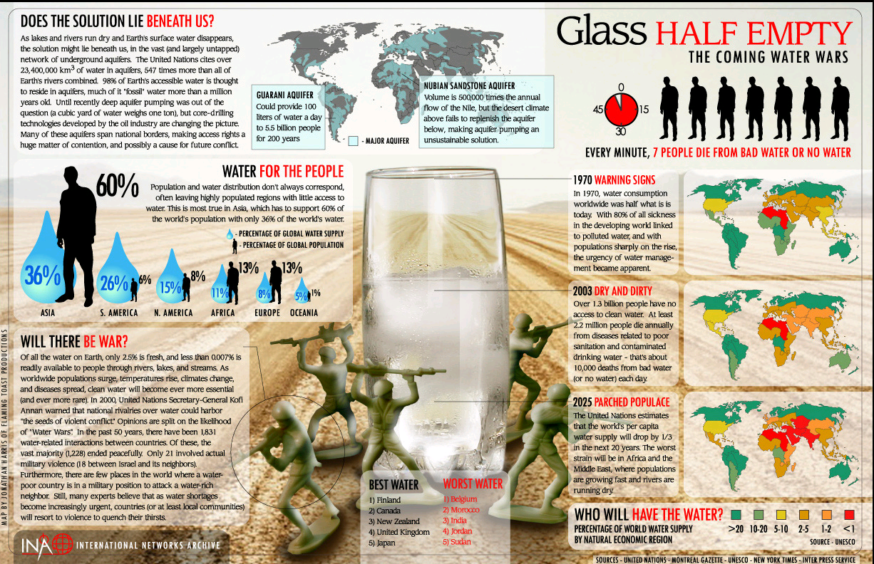
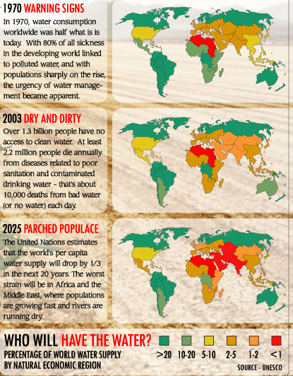
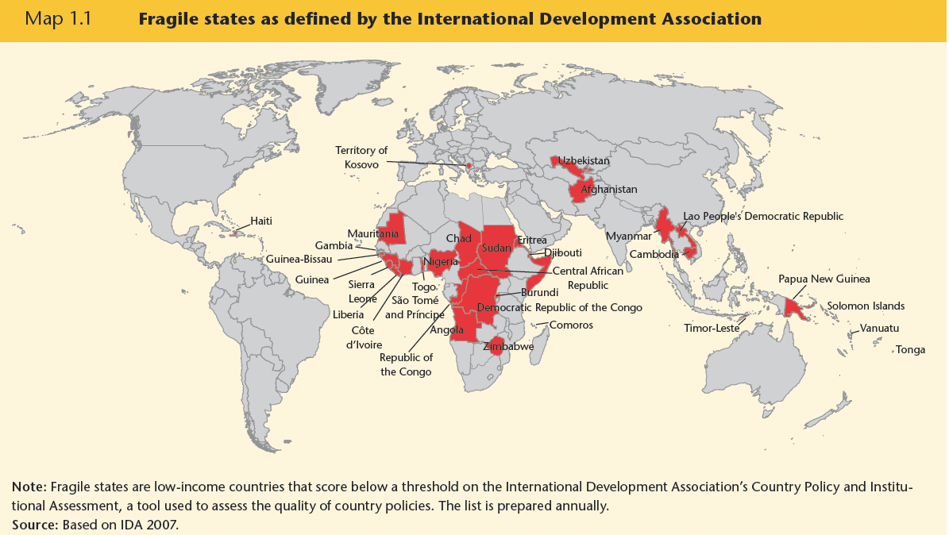
Clear evidence?
The is a correlation between ‘fragility’ and water scarcity and shortage
Notes:
‹#›

Slide 5
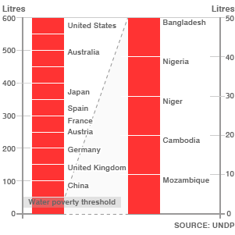
The water gap:
Huge differences in water use across the development divide
Ironically water is usually more expensive (in absolute and relative terms in the developing world -
For 1000 litres of water:
Slums of Dar es Salaam $8
Municipal supply Dar es Salaam $0.34
UK tap water $1.62
USA $0.68
Notes:
‹#›

Slide 6
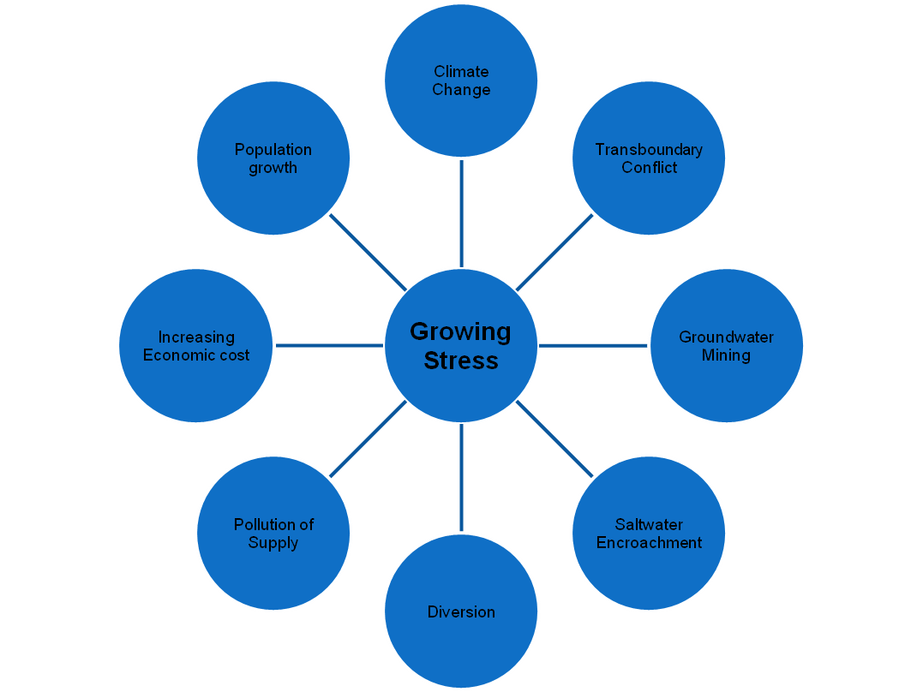
Widening gap?
Climate change will affect many developing regions, which cannot afford to adapt. Those who rely on glacier melt in the Andes and Himalaya are especially at risk.
Transboundary conflicts, unless resolved carefully and peacefully, will lead to winners and losers
In some locations groundwater mining of ancient water will not be replenished by recharge.
In coastal areas over-abstraction is leading to pollution by saltwater.
Large scale diversion projects such as China’s South-North Water Transfer will also lead to winners and losers.
Pollution is depleting useable supplies in many locations
The costs of water supply, especially in growing developing megacities, are rising.
Population growth will tip some areas of surplus or balance, into deficit.
Notes:
‹#›

Slide 7
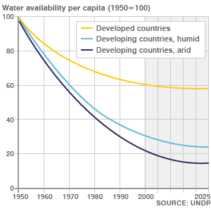
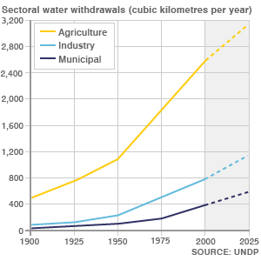
Water Conflicts: the water crisis
Significant areas under increasing water stress and rising water scarcity
Water availability falling – long term trends
Huge increases in use, especially for farming.
Notes:
‹#›

Slide 8
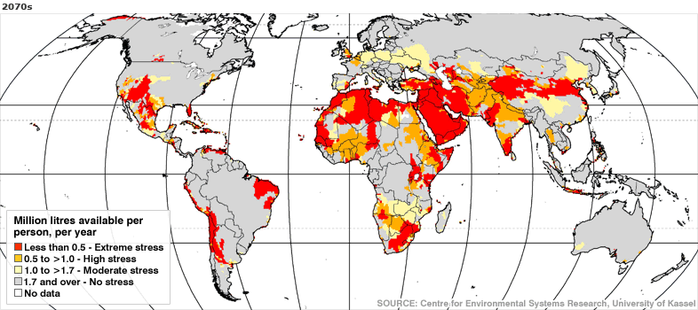
Fears for the future - 2070
There seems to be a widening gap between the ‘haves’ and the ‘have-nots’
Notes:
‹#›

Slide 9
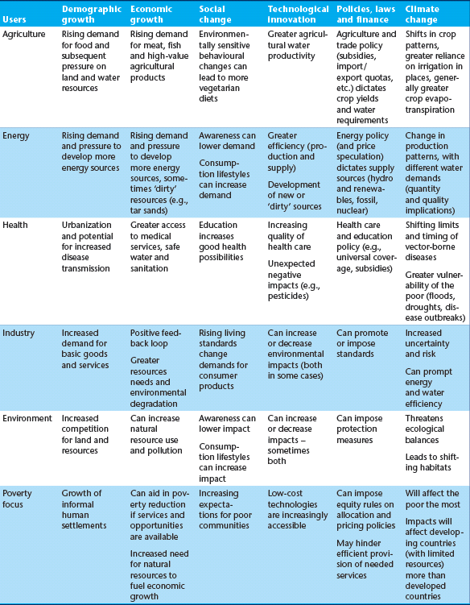
Other pressures
There is a strong link between development and water consumption.
The drivers in the table create pressures on society that lead to changes in water usage.
Notes:
‹#›

Slide 10
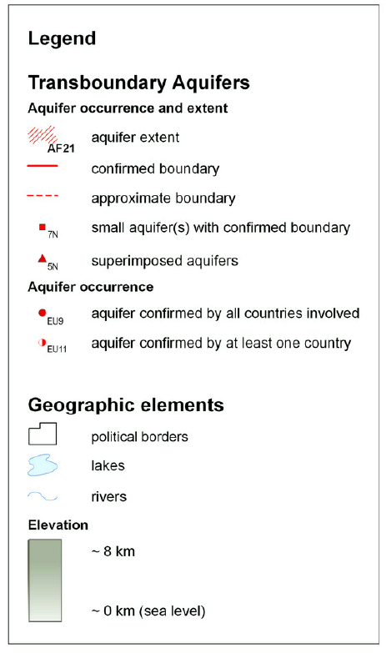
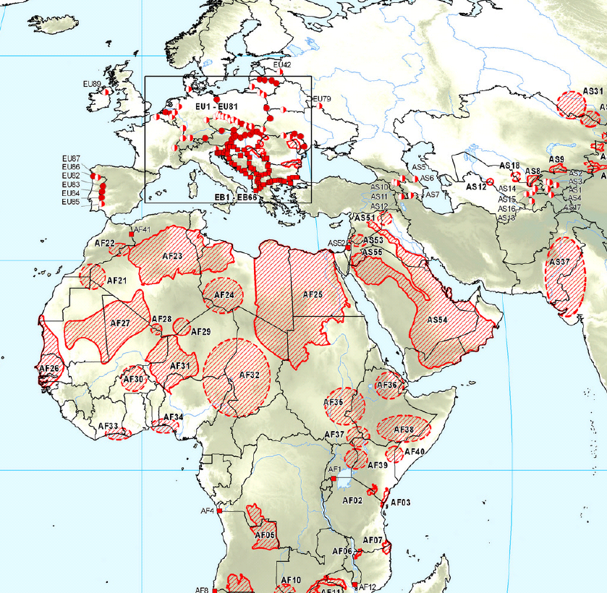
Trans-boundary water resources?
Notes:
‹#›

Slide 11
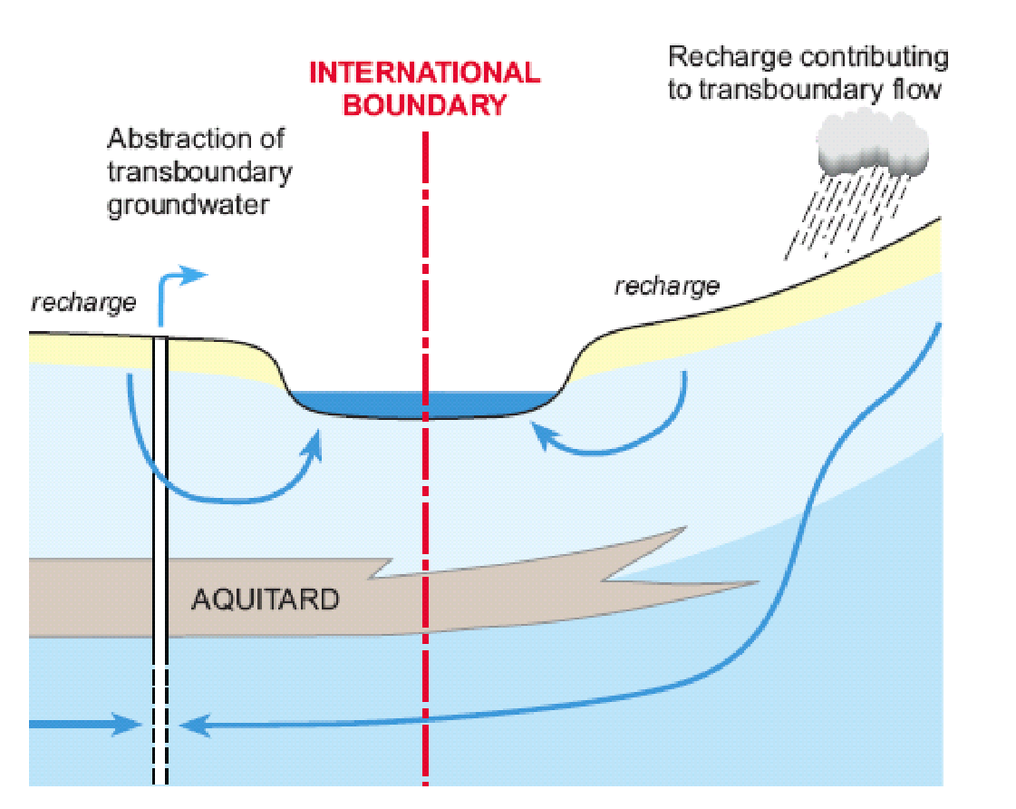
More on transboundary water
Approximately 40% of the world’s population lives in river and lake catchments that fall across two or more countries, and over 90 % live in countries that share basins. The existing transboundary lake and river catchments cover nearly one half of the Earth’s land surface and account for an estimated 60 % of global freshwater flow. About 2 billion people worldwide depend on groundwater, which includes approximately 300 transboundary aquifer systems.
The transboundary basins and aquifers link populations of different countries and support the incomes and livelihoods of hundreds of millions of people worldwide
Notes:
‹#›

Slide 12
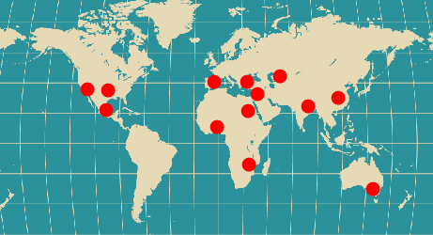
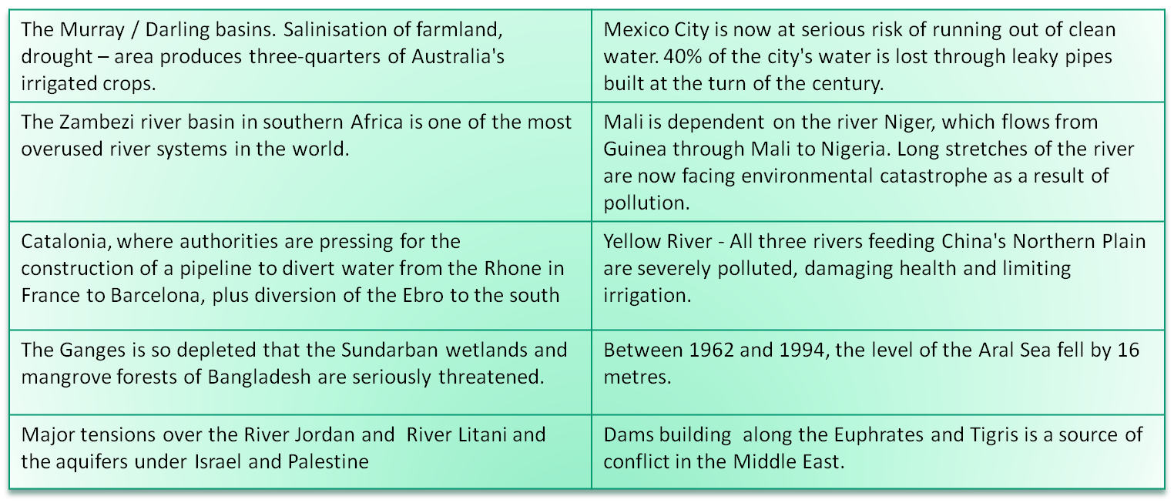
Increasing conflict in transboundary hotspots
Notes:
‹#›

Slide 13
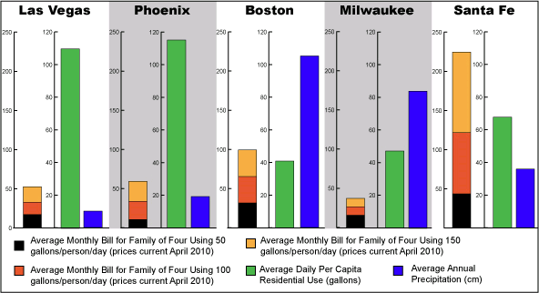
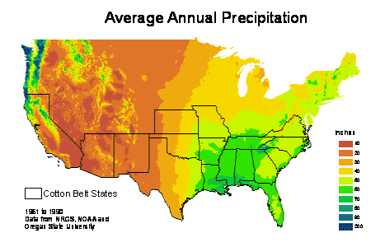
Example: USA – inter-regional issues
1
2
Question of miss-match between precipitation and usage
1
2
Notes:
‹#›

Slide 14
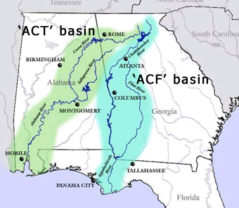
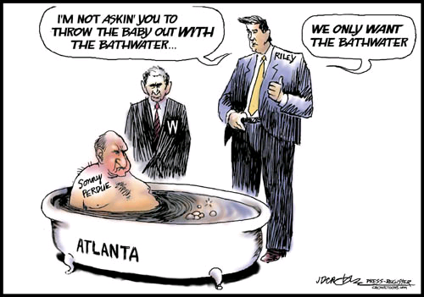
USA Transboundary Conflicts
“The problem is Atlanta...it's too big, too dirty and too thirsty and it winds up soakin' up everybody else's water”
For almost two decades, Georgia, Alabama and Florida have been battling over the future allocation of water in two major river basins that cross their borders. Georgia wants to have enough water to allow urban Atlanta to continue growing, while Alabama and Florida ( downstream users) want enough water flowing for their own economic well-being.
http://blog.al.com/jdcrowe/2007/10/alabamageorgia_water_wars.html
Notes:
‹#›

Slide 15
To what extent is it a problem?
“Those who warn us of looming water wars usually base their arguments on an appeal to emotion, rather than on fact”
We started with these………
The news media today are full of talk of crises…….linked to each other and to water resources management. They arise against a background of continuing poverty for a large part of the world. Unless resolved, they may lead to increasing political insecurity and conflict at local and national levels
Notes:
‹#›

Slide 16
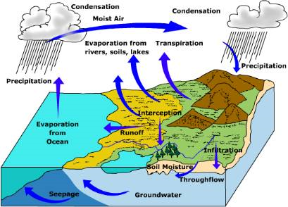
But water is renewable.......
Water is renewable, but finite. As global demands increase against this finite supply, competition for water is intensifying not just between countries, but also within countries—between rural and urban, states, regions and provinces, ethnic groups, and economic interests etc. The escalation of these tensions poses a great threat of civil unrest, humanitarian crises, and loss of life, compared to potential international wars over water. Perhaps the most worrying trends are global water-related threats rising food prices and increased hunger, linked to climate change and changes in the predictability of supply, i.e. the rainfall patterns
The water cycle is a closed system
Notes:
‹#›

Slide 17
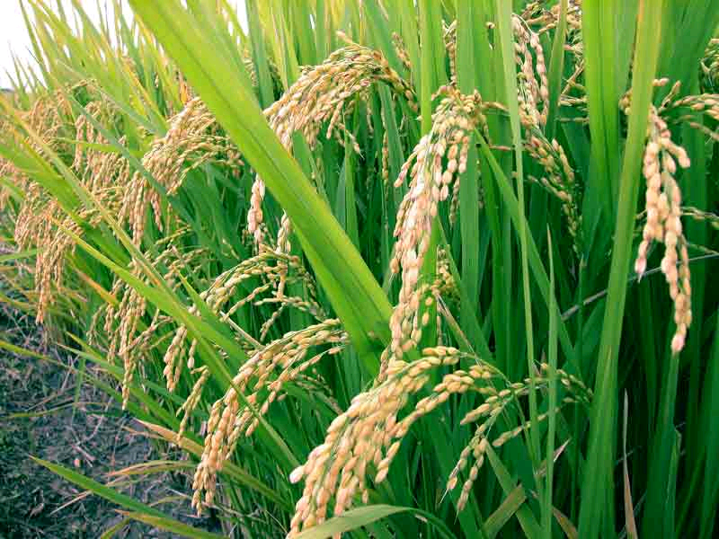
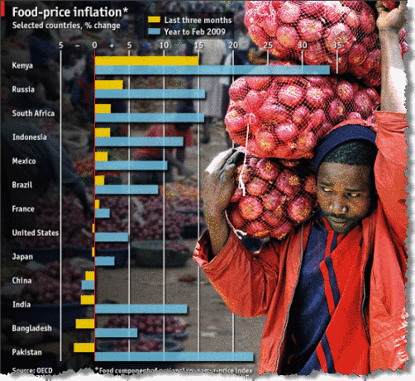
Agriculture will be the future biggest demand
A big concern is that shortages in water will intensify the already rising trend of global food prices.
This is linked to climate change and changes in the predictability of supply, i.e. the rainfall patterns.
Notes:
‹#›

Slide 18

The path to solutions
Solutions will require investments in sustainable development, but who should pay?
The United States, Europe, China, India and other BRICs will have to join forces to help conflict-prone parts of Africa, the Middle East and Asia to raise food output.
To head off even more devastating climate shocks in coming decades, there must be an end the deadlock over climate-change policy.
Technology such as drought-resistant crops, solar-thermal power and drip irrigation can help reduce water stress and improve quality of life.
Source: Land, Water and Conflict Newsweek 2008
Notes:
‹#›

Slide 19
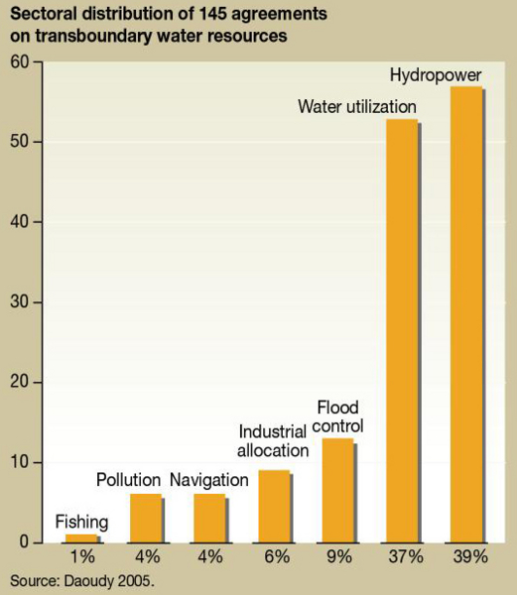
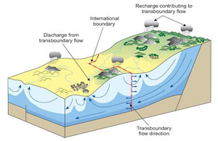
Transboundary solutions may also be important
Potential transboundary impacts and conflicting interests can best be solved by cooperation, adequate legal and institutional frameworks, joint approaches to planning and sharing of benefits and related costs.
Such approaches may bring other benefits in the form of building trust among the stakeholders / players and making cooperative water management solutions possible.
http://maps.grida.no/go/graphic/transboundary-water-governance-averting-conflict

Slide 20
Final summary
The water management challenges are becoming increasingly complex. New and growing demands increasingly strain scarce and unreliable supplies and cross physical, cultural and political boundaries.
Solutions open up opportunities for capacity development and technical, social, legal and economic cooperation.
‘Water wars’ are a risk in terms of food price instability and issues of inequality, but solutions are possible if there is the political incentive to better manage the resource.

